Slide 1
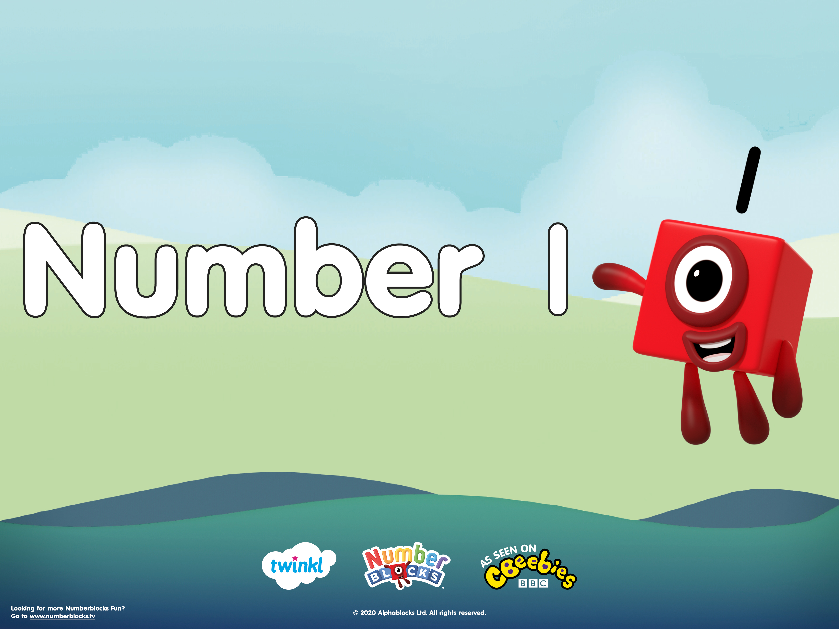

Slide 2




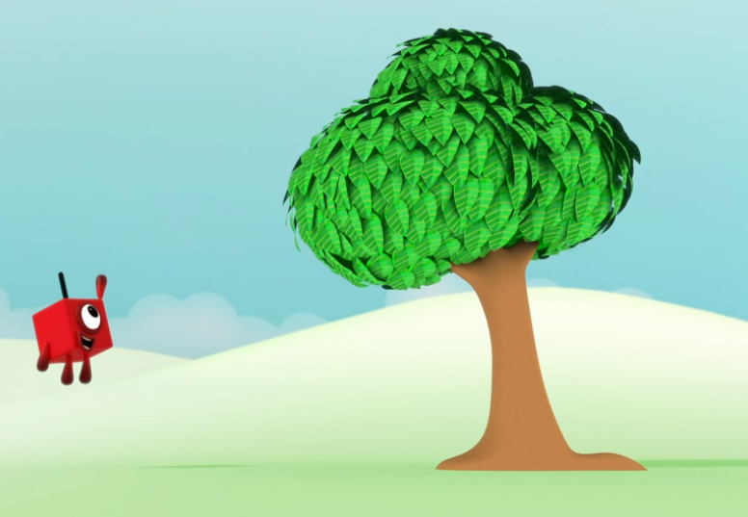




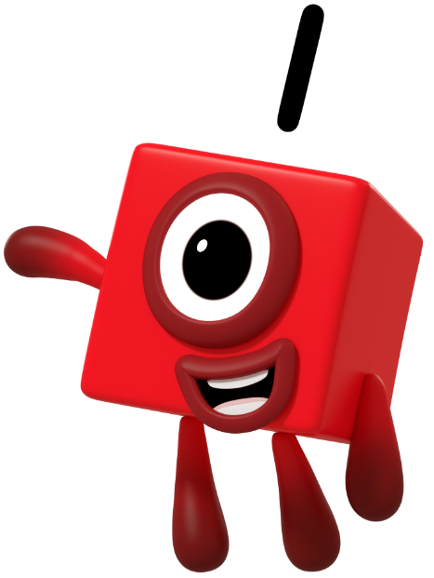
What can you see in the picture?

Slide 3
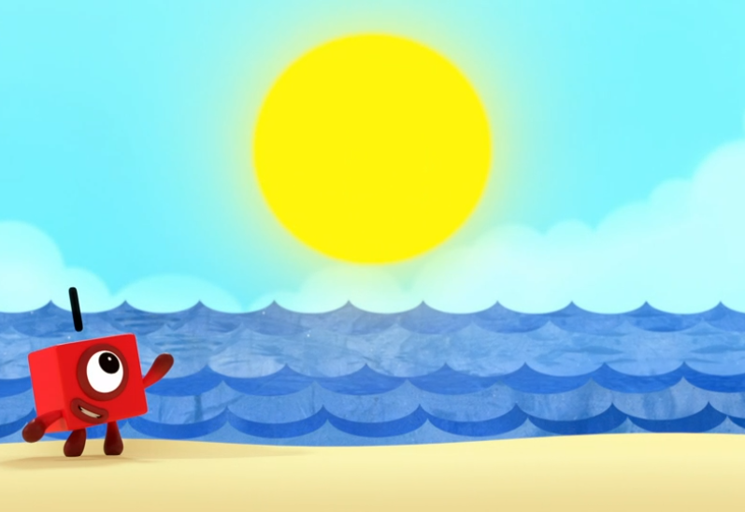
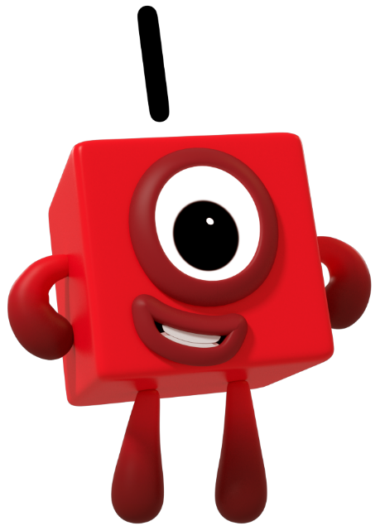
How many suns are in the sky?
Can you show me using your fingers?

Slide 4
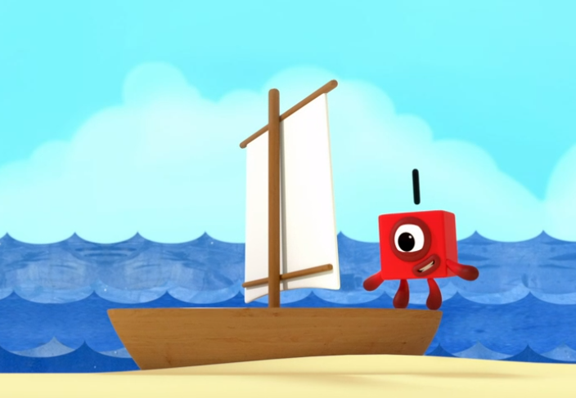
I can see 1 boat. Am I right?
How do you know?

Slide 5
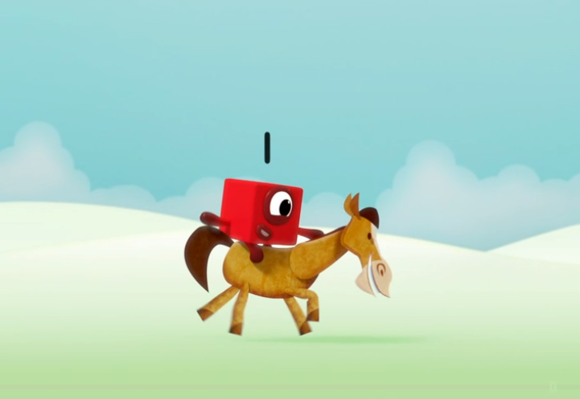
What can you spot in the picture?

Slide 6
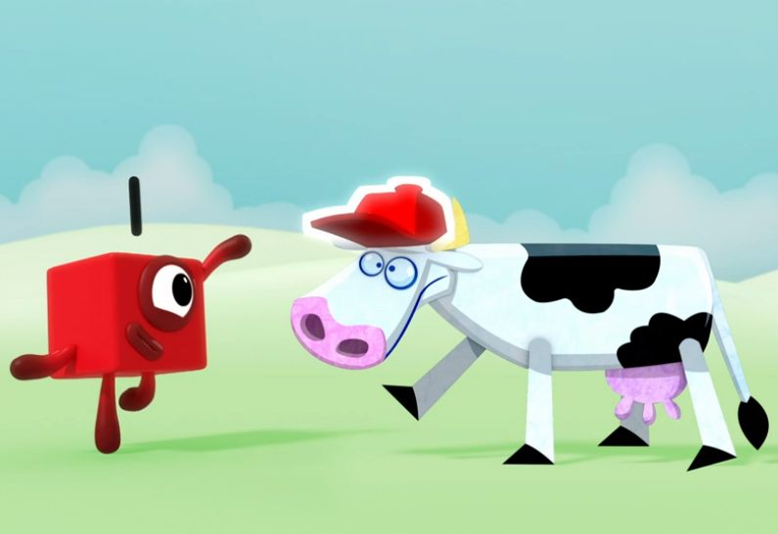
What can you see in this picture? Can you count each thing? How many of each are there?

Slide 7
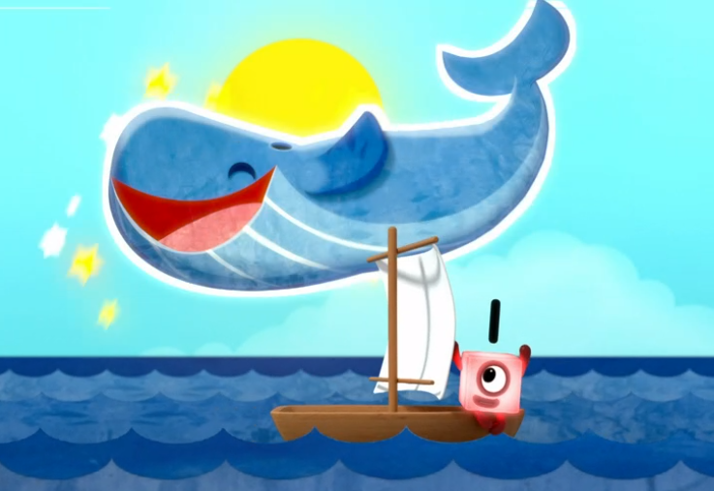
I can see 1 whale and 1 boat.
Am I right? How do you know?

Slide 8
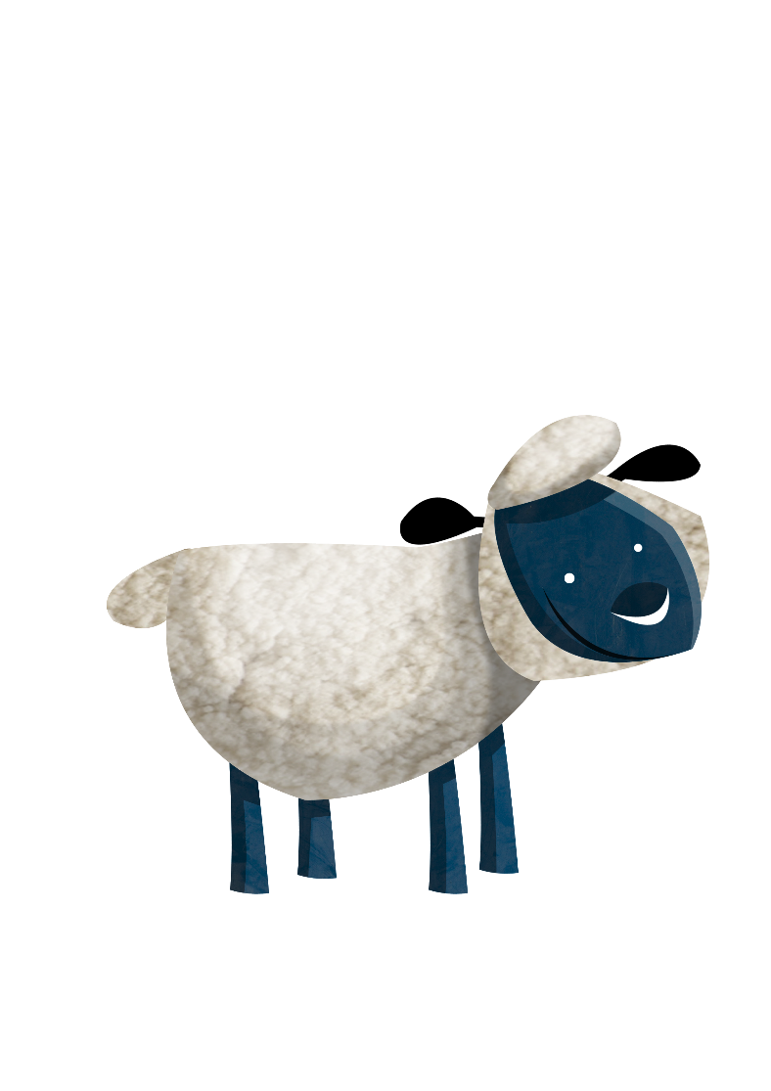

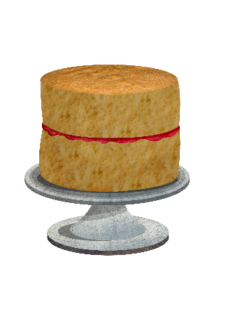
What is happening in this picture?
How many sheep are there? How many cakes are there?

Slide 9
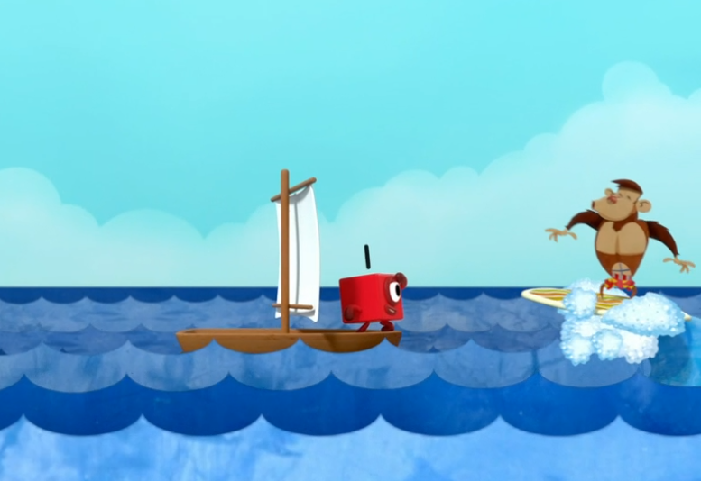
What do you notice in this picture?

Slide 10

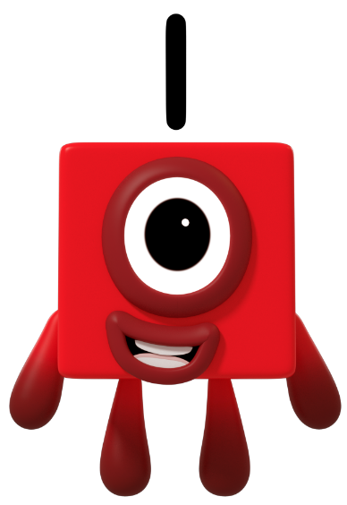
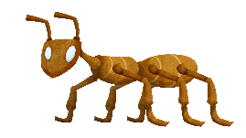
Can you spot the difference between the two pictures?

Slide 11

What do you notice about the two pictures?
What is the same? What is different?

Slide 12
One has the number one, above her head.
Can you show me one finger?
Can you trace a one in the air?
Start at the top and go straight down.

Slide 13
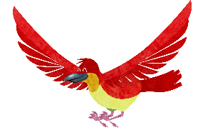

What’s the same about the 2 pictures?
What’s different about the 2 pictures?

Slide 14
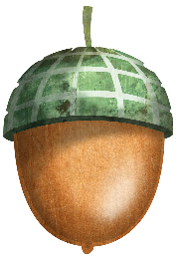


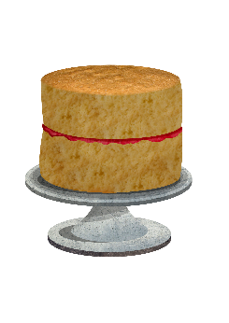

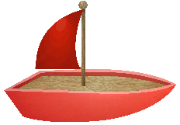

1 Wonderful World and 1 Me!

Slide 15
