Slide 2
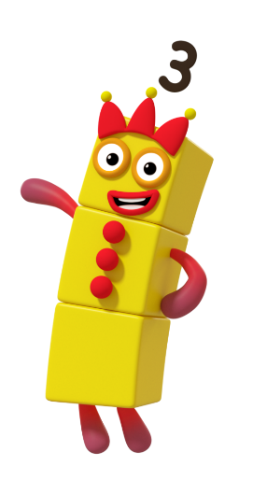
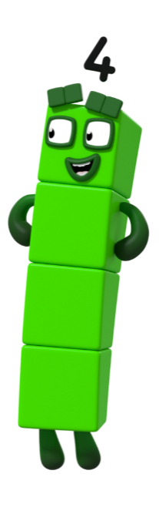
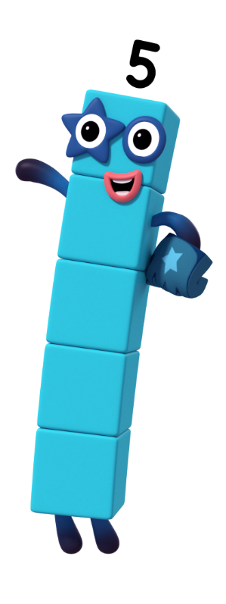

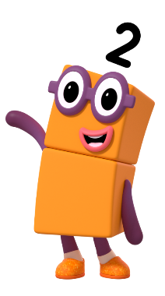
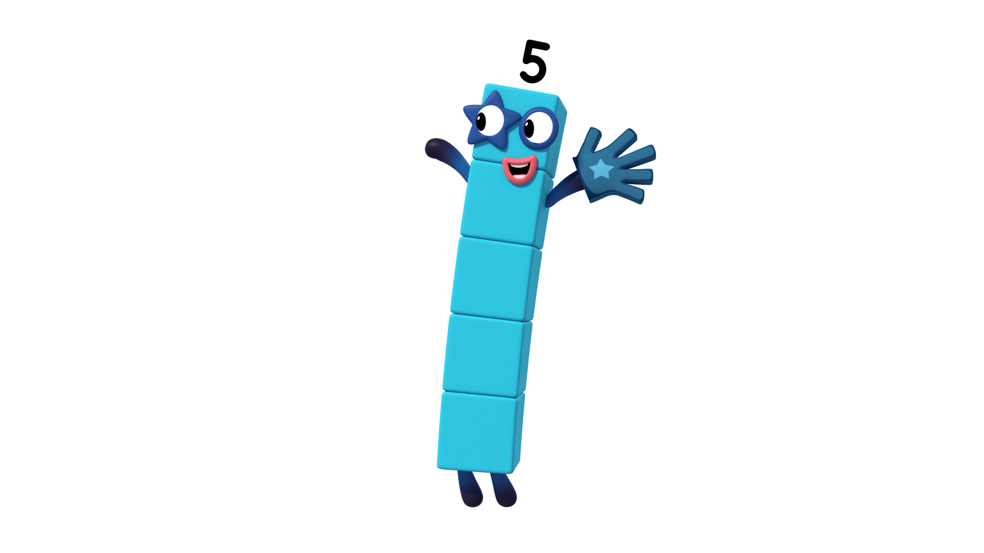
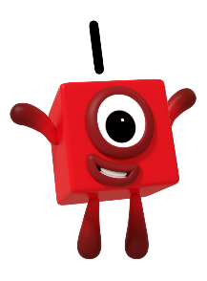
next
Can you help me to count my fingers?
Click on me to help!

Slide 3
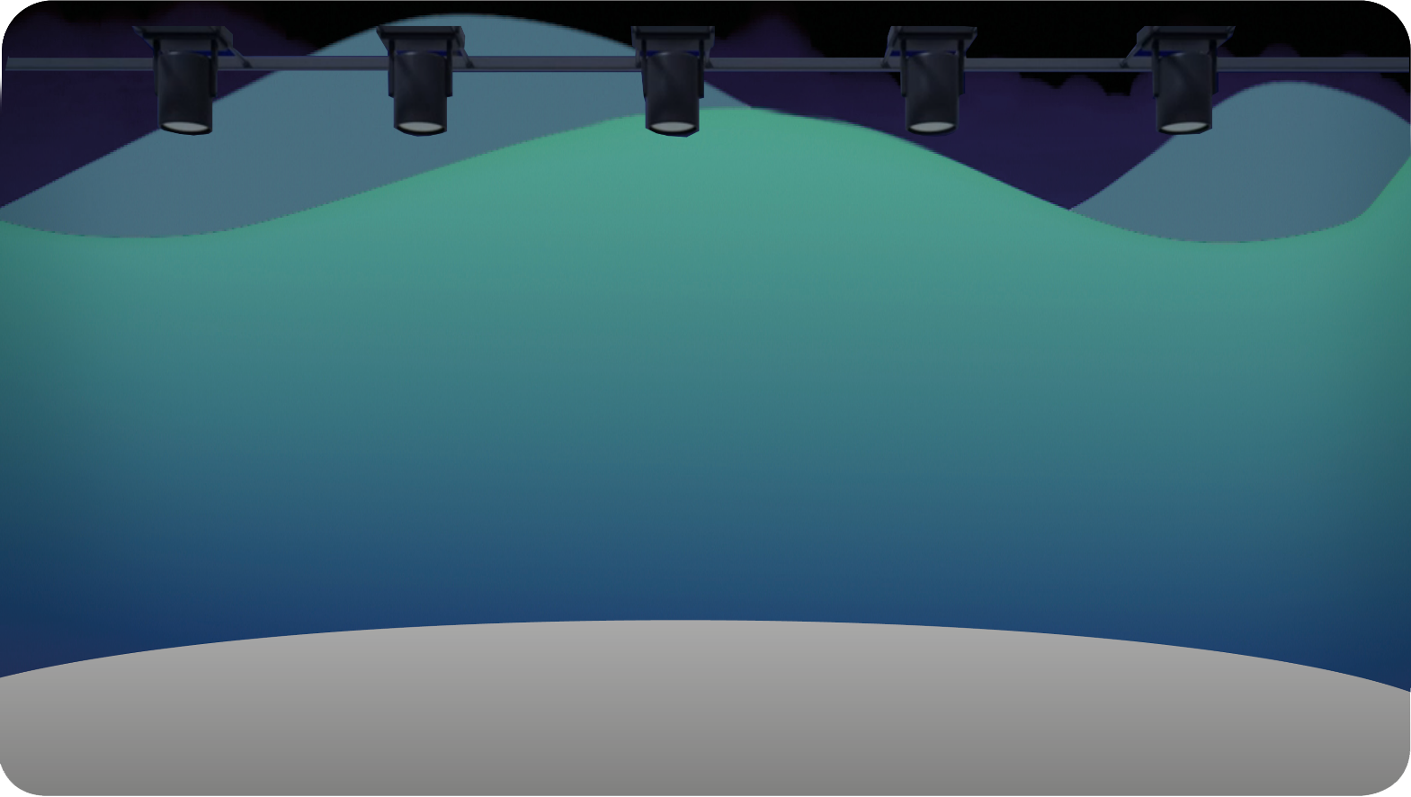



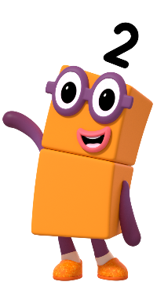
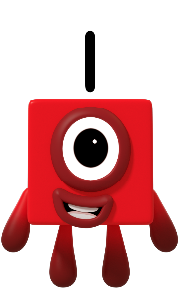
next
Meet the Numberblock Band! Can you count how many members are in the band?
Can you show 5 on your fingers? Is there another way to show 5 using your fingers? How do you know? Can you show me?

Slide 4

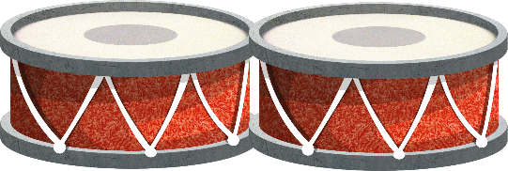

next
Click the bongos. Listen carefully. How many times can
you hear it being played?
That’s right, I played the bongos 4 times!
It wasn’t me. Try again!
It wasn’t me. Try again!
It wasn’t me. Try again!
It wasn’t me. Try again!
Choose the Numberblock on the stage
that you think played the bongos.

Slide 5
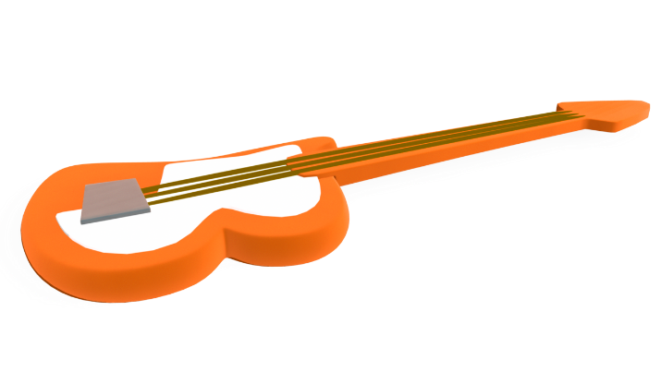

next
Click the guitar. Listen carefully. How many times can
you hear it being played?
It wasn’t me. Try again!
It wasn’t me. Try again!
It wasn’t me. Try again!
It wasn’t me. Try again!
That’s right, I played the guitar 3 times!
Choose the Numberblock on the stage
that you think played the guitar.

Slide 6
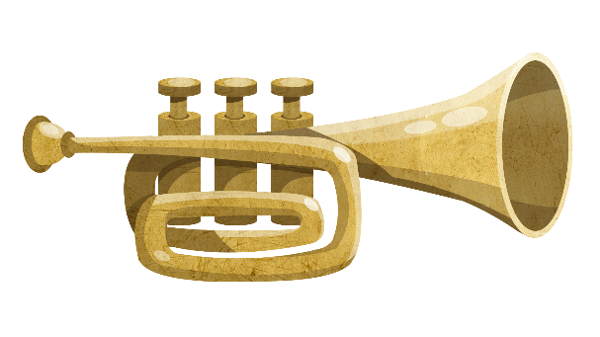

next
Click the trumpet. Listen carefully. How many times can
you hear it being played?
It wasn’t me. Try again!
It wasn’t me. Try again!
That’s right, I played the trumpet 1 time!
It wasn’t me. Try again!
It wasn’t me. Try again!
Choose the Numberblock on the stage
that you think played the trumpet.

Slide 7
next
Click the hand. Listen carefully. How many claps can you hear the Numberblock make?
It wasn’t me. Try again!
It wasn’t me. Try again!
It wasn’t me. Try again!
That’s right,
I clapped 5 times!
It wasn’t me. Try again!
Choose the Numberblock on the stage
that you think is clapping.

Slide 8
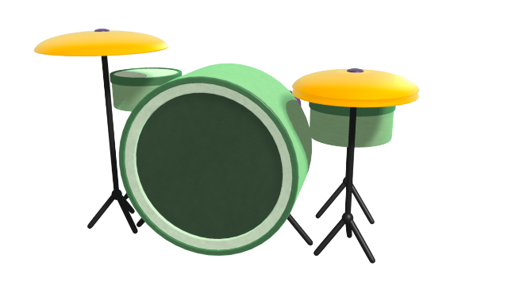


next
Click the drum kit. Listen carefully. How many times can
you hear it being played?
It wasn’t me. Try again!
That’s right, I played the drum kit 2 times!
It wasn’t me. Try again!
It wasn’t me. Try again!
It wasn’t me. Try again!
Choose the Numberblock on the stage
that you think played the drum kit.

Slide 9

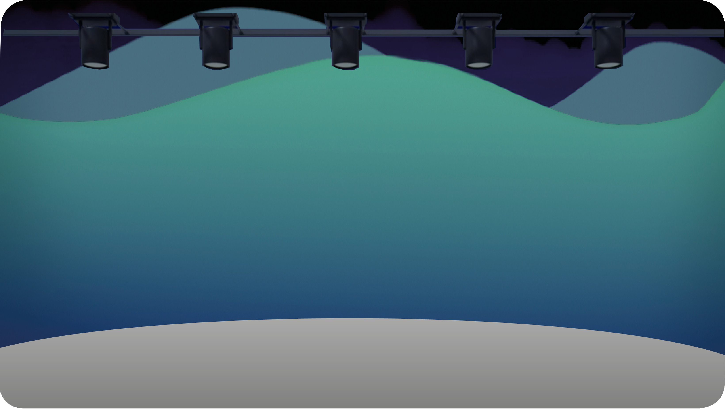
next
Can you clap along with the Numberblocks’ Band?
Click my hand to find out how many times we need to clap.
Can you clap 3 times? Can you count each clap?

Slide 10

next
Can you clap along with the Numberblocks’ Band?
Click my hand to find out how many times we need to clap.
Can you clap once?
Can you count each clap?

Slide 11

next
Can you clap along with the Numberblocks’ Band?
Click my hand to find out how many times we need to clap.
Can you clap 5 times? Can you count each clap?

Slide 12

next
Can you clap along with the Numberblocks’ Band?
Click my hand to find out how many times we need to clap.
Can you clap 2 times? Can you count each clap?

Slide 13

next
Can you clap along with the Numberblocks’ Band?
Click my hand to find out how many times we need to clap.
Can you clap 4 times? Can you count each clap?

Slide 14
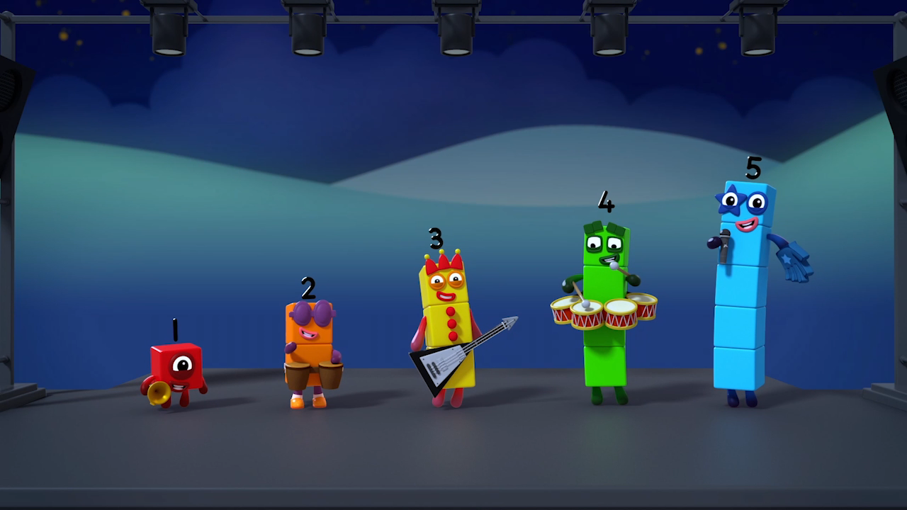
finish
Well done for helping the Numberblocks’ Band!
Well done, great clapping! What other actions could we do?

