Slide 2
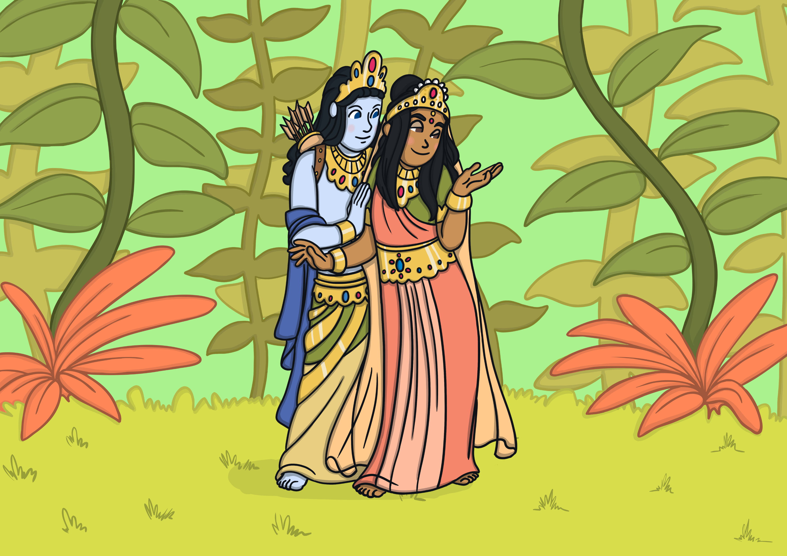
Once upon a time, there was a great warrior called Prince Rama. He had a beautiful wife named Sita.

Slide 3
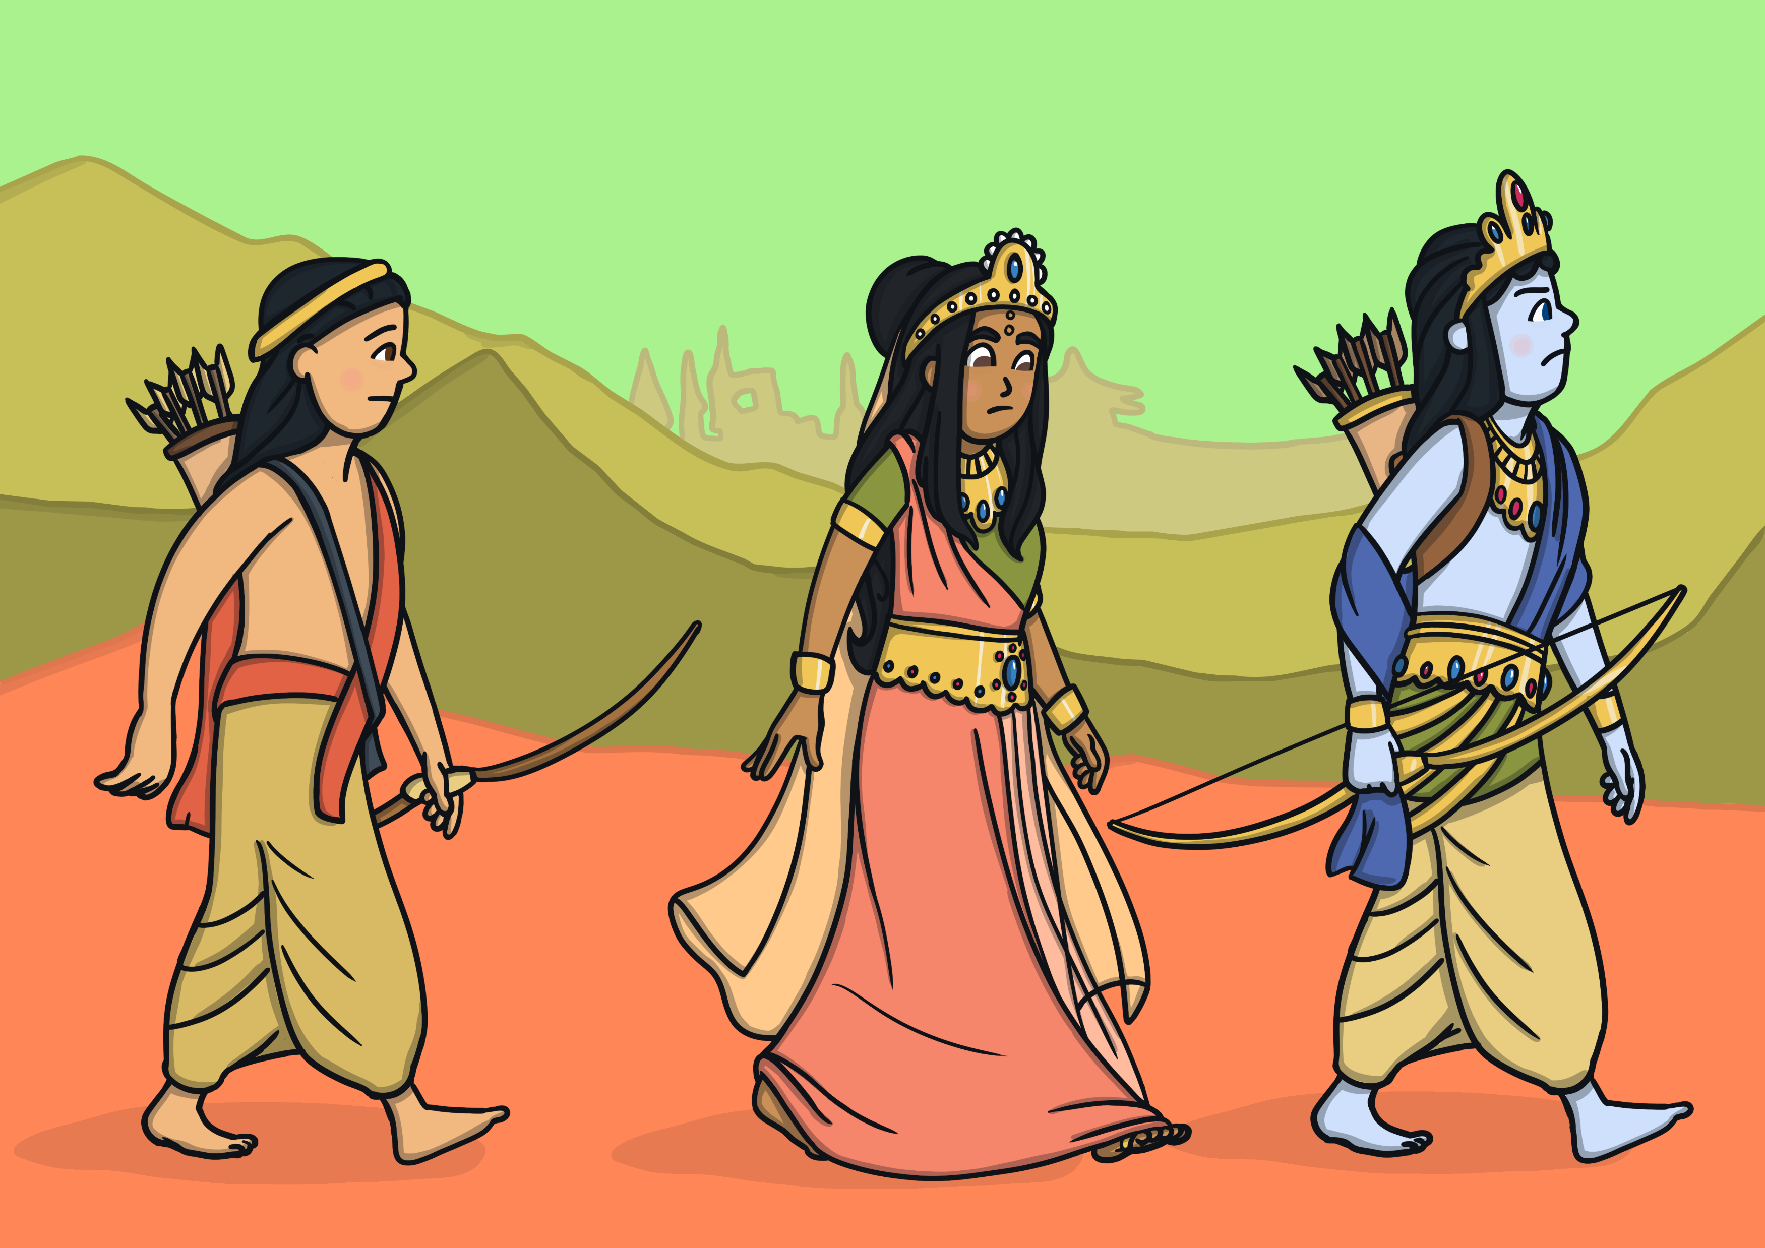
One day, Rama and Sita were banished from their home by the King. They went to live in the forest with Rama's brother, Lakshmana.

Slide 4
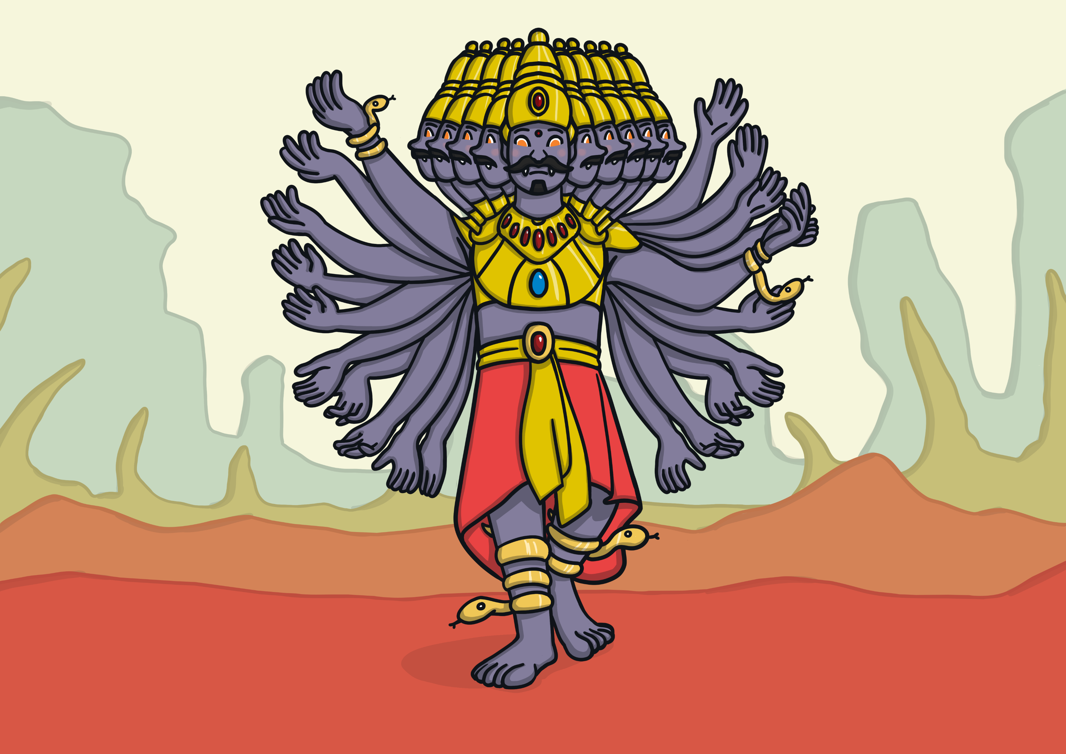
A terrible demon king, named Ravana, lived nearby. He had ten heads and 20 arms and was feared throughout the land.

Slide 5
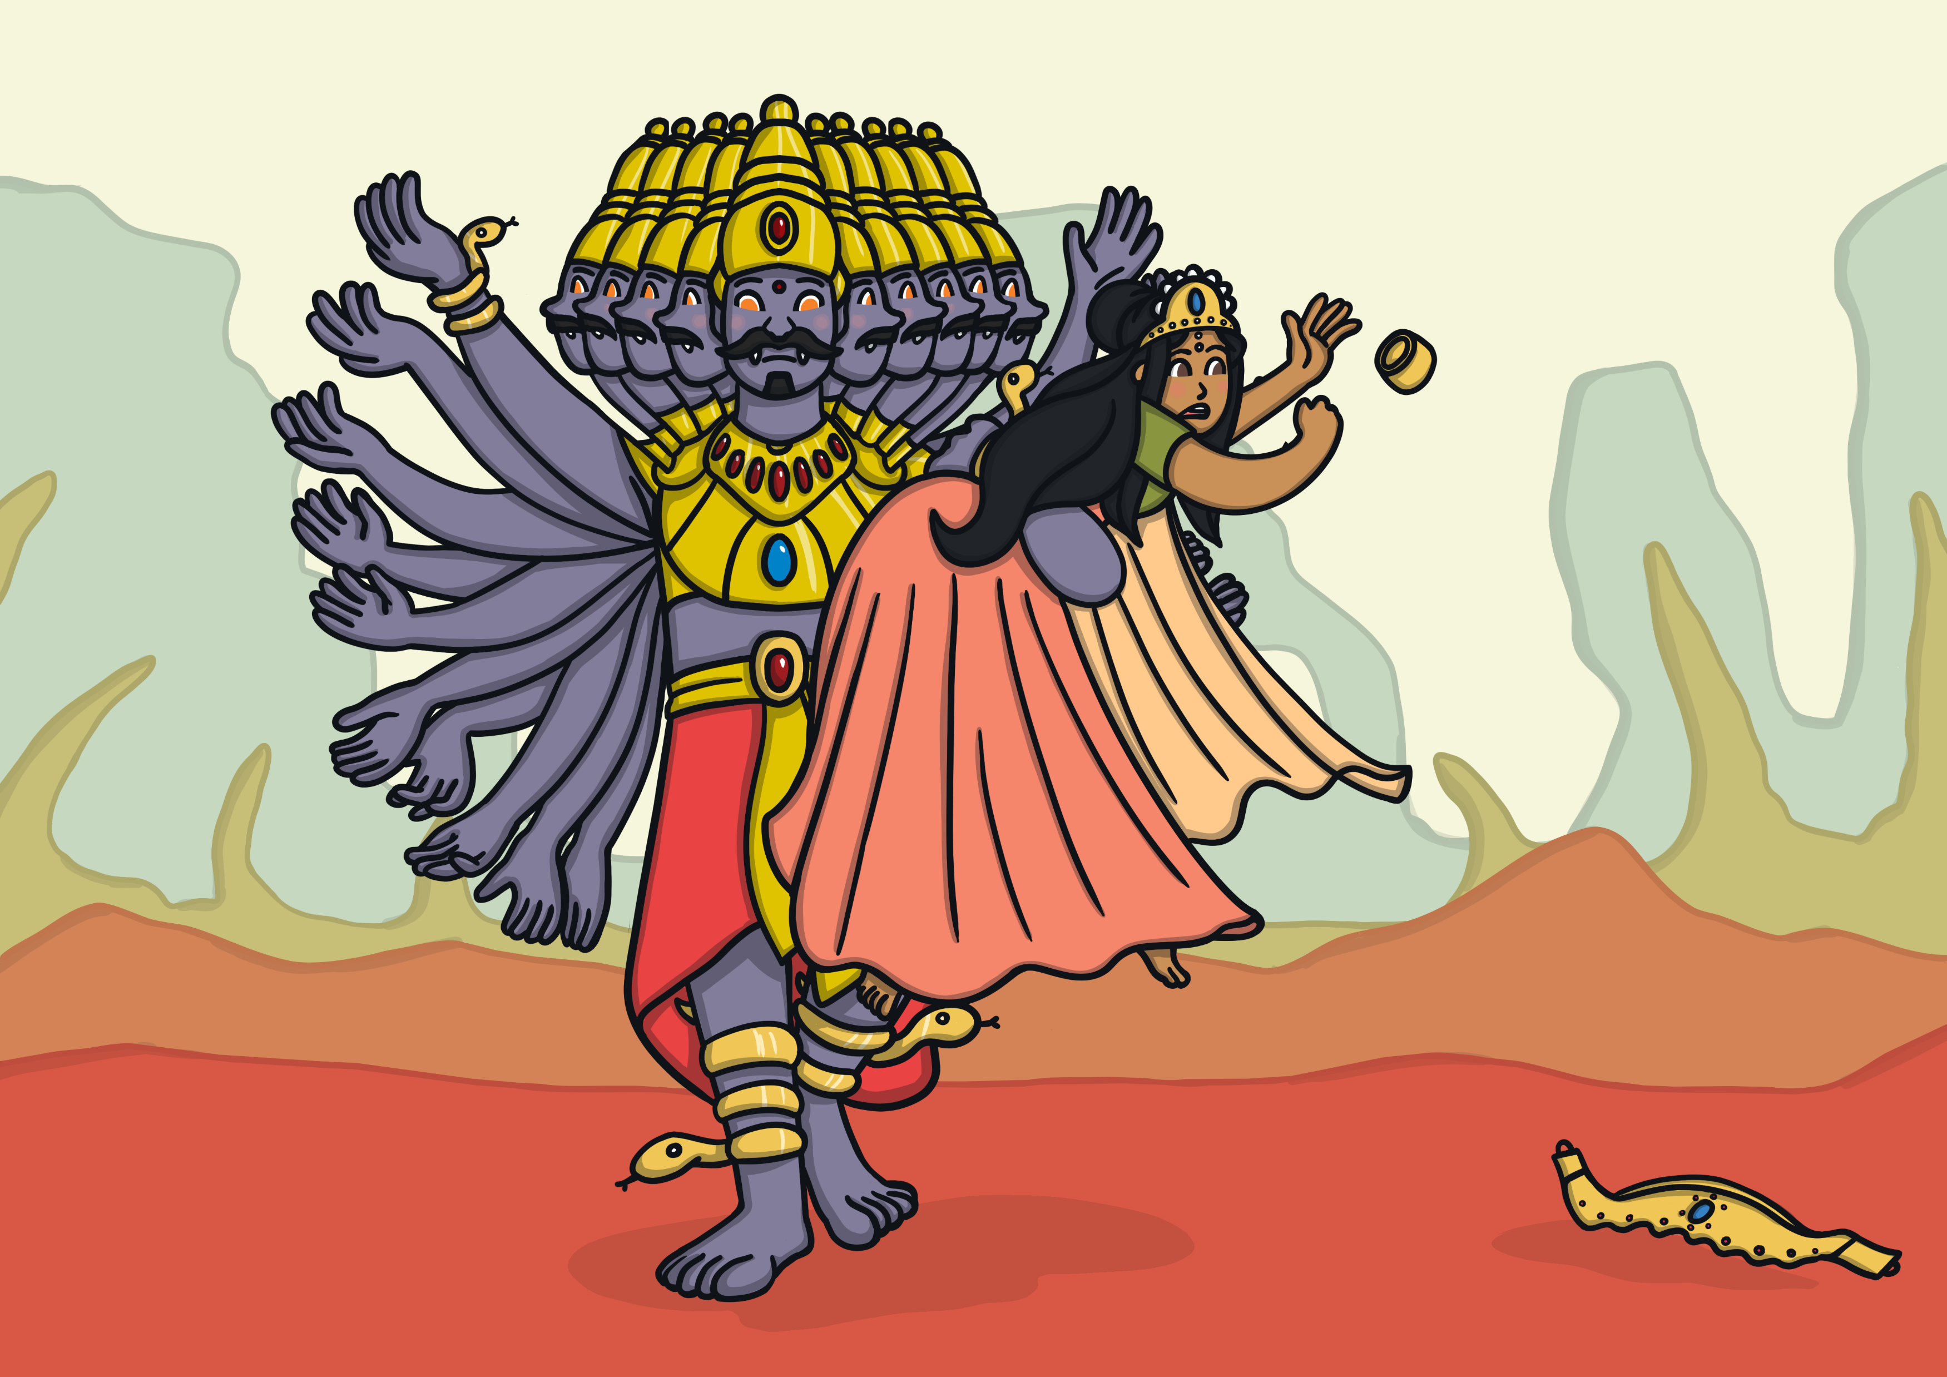
One day, Ravana kidnapped Sita and took her away in his flying chariot. Clever Sita left a trail of her jewellery for Rama to follow.

Slide 6
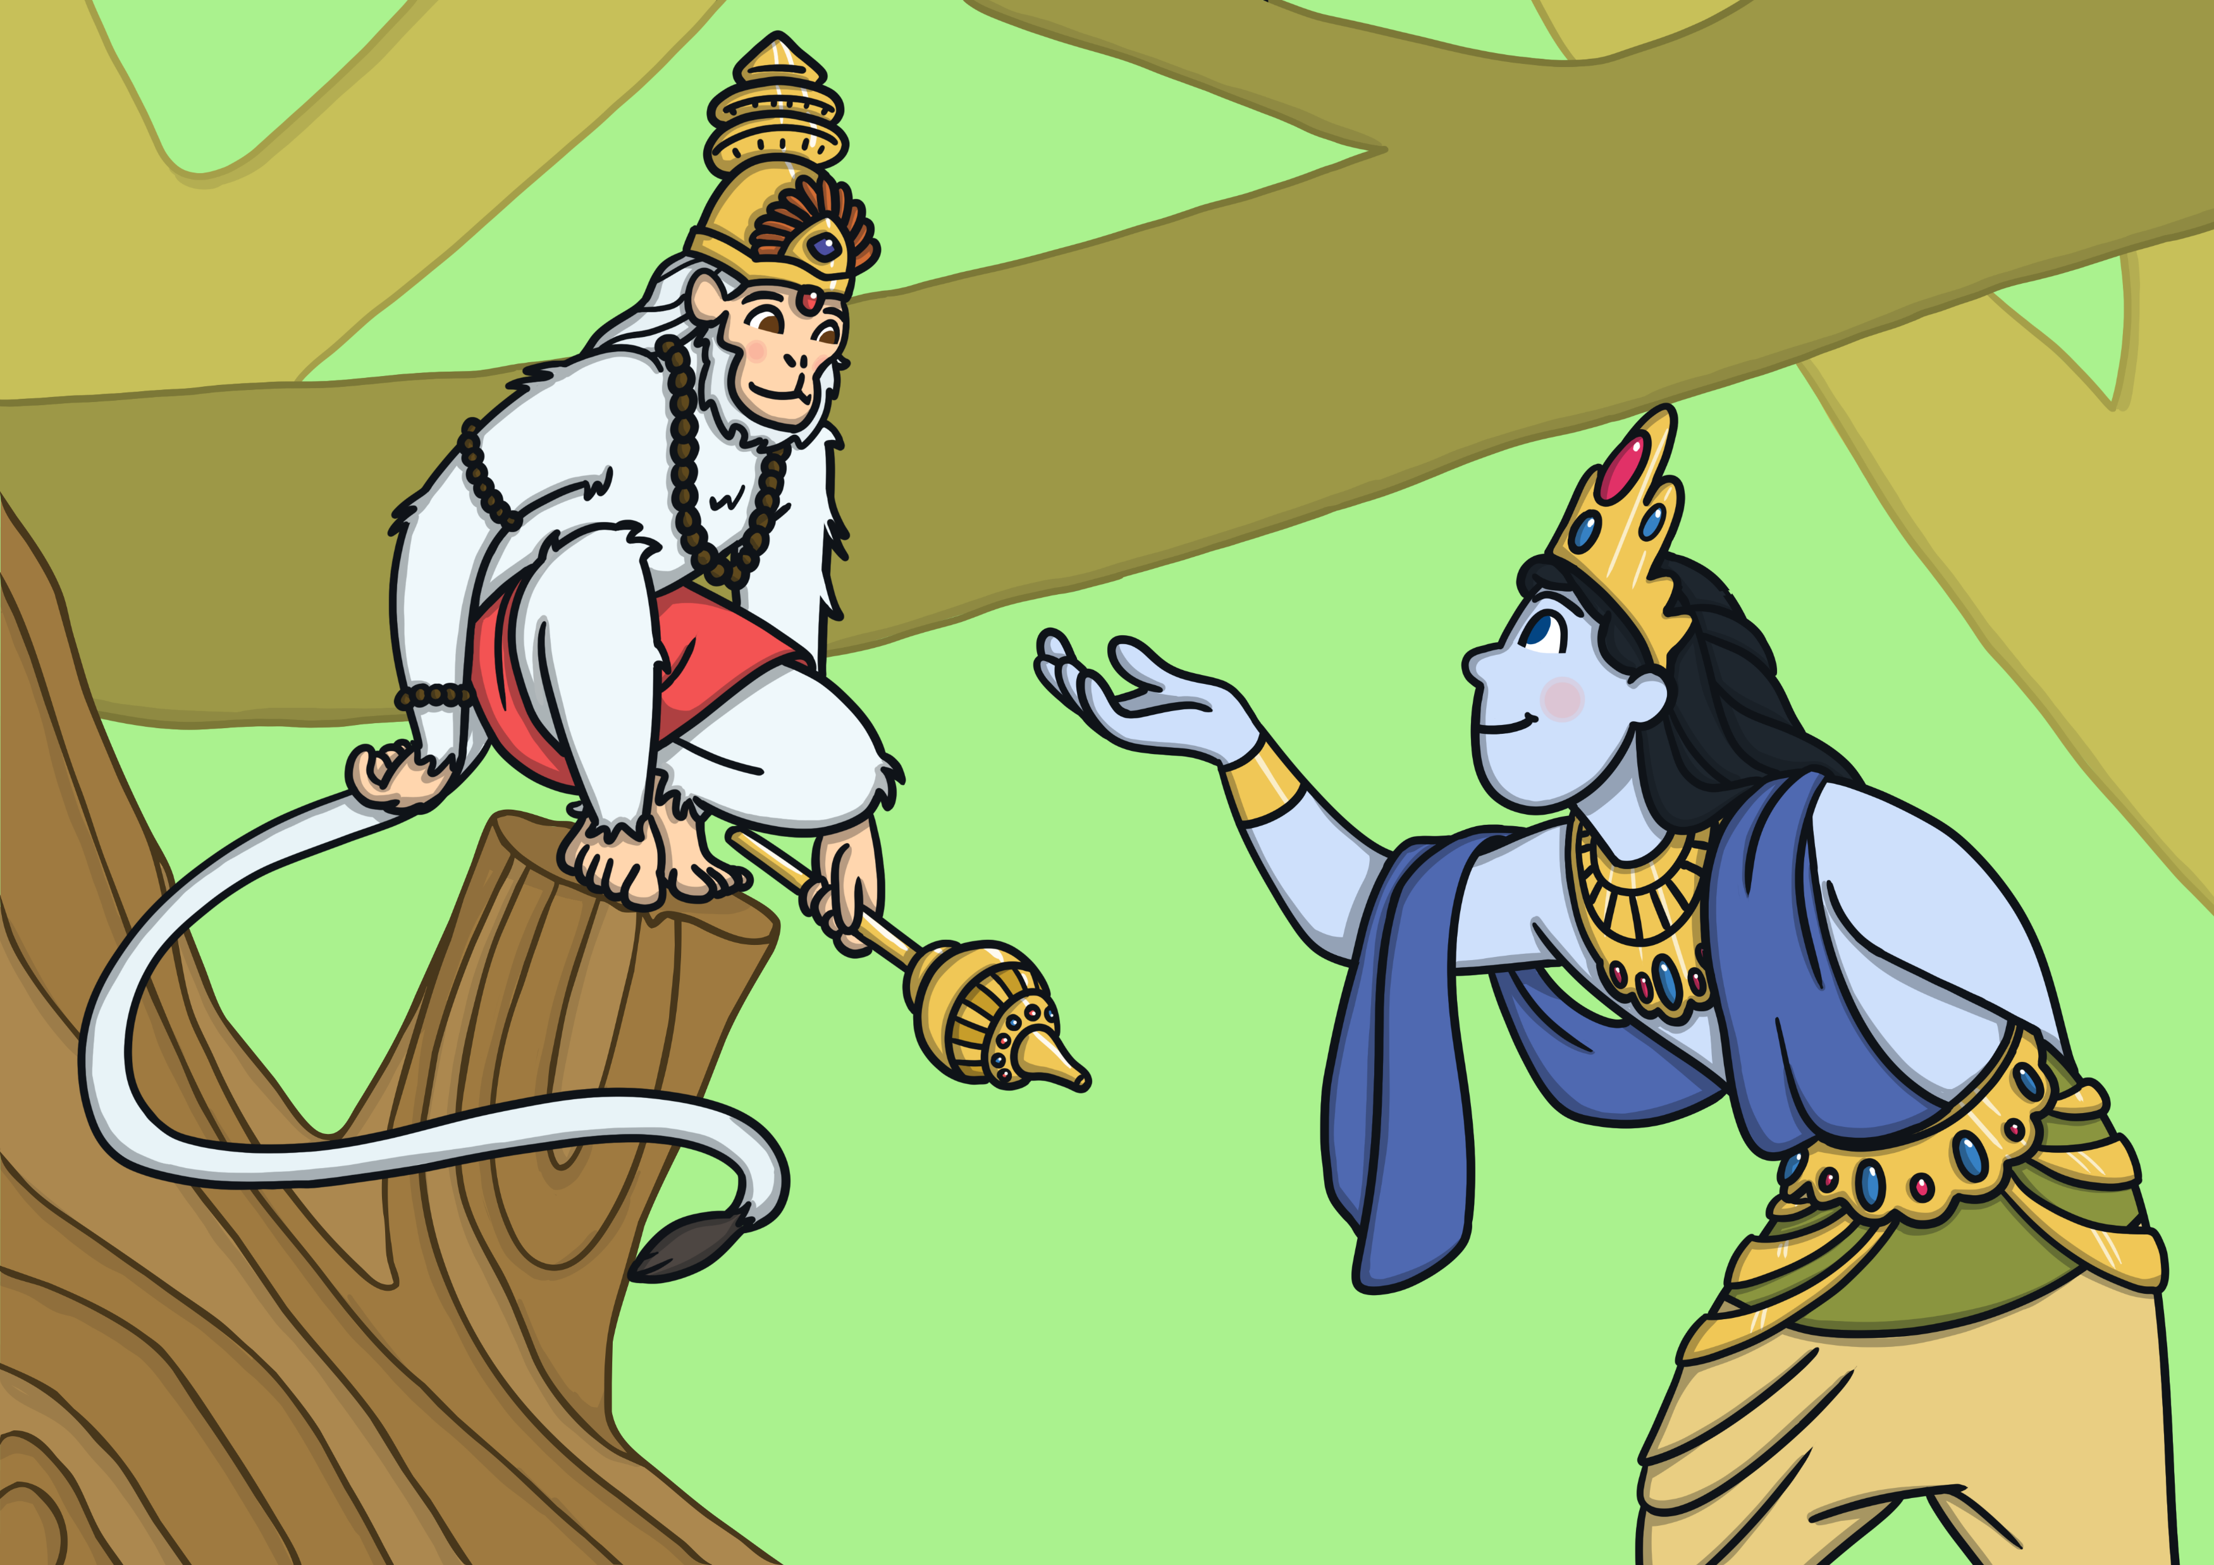
Rama and Lakshmana followed the trail of glittering jewellery until they met Hanuman, the Monkey King, who became their friend and agreed to help find Sita. Messages were sent to all the monkeys in the world to help find Sita.

Slide 7
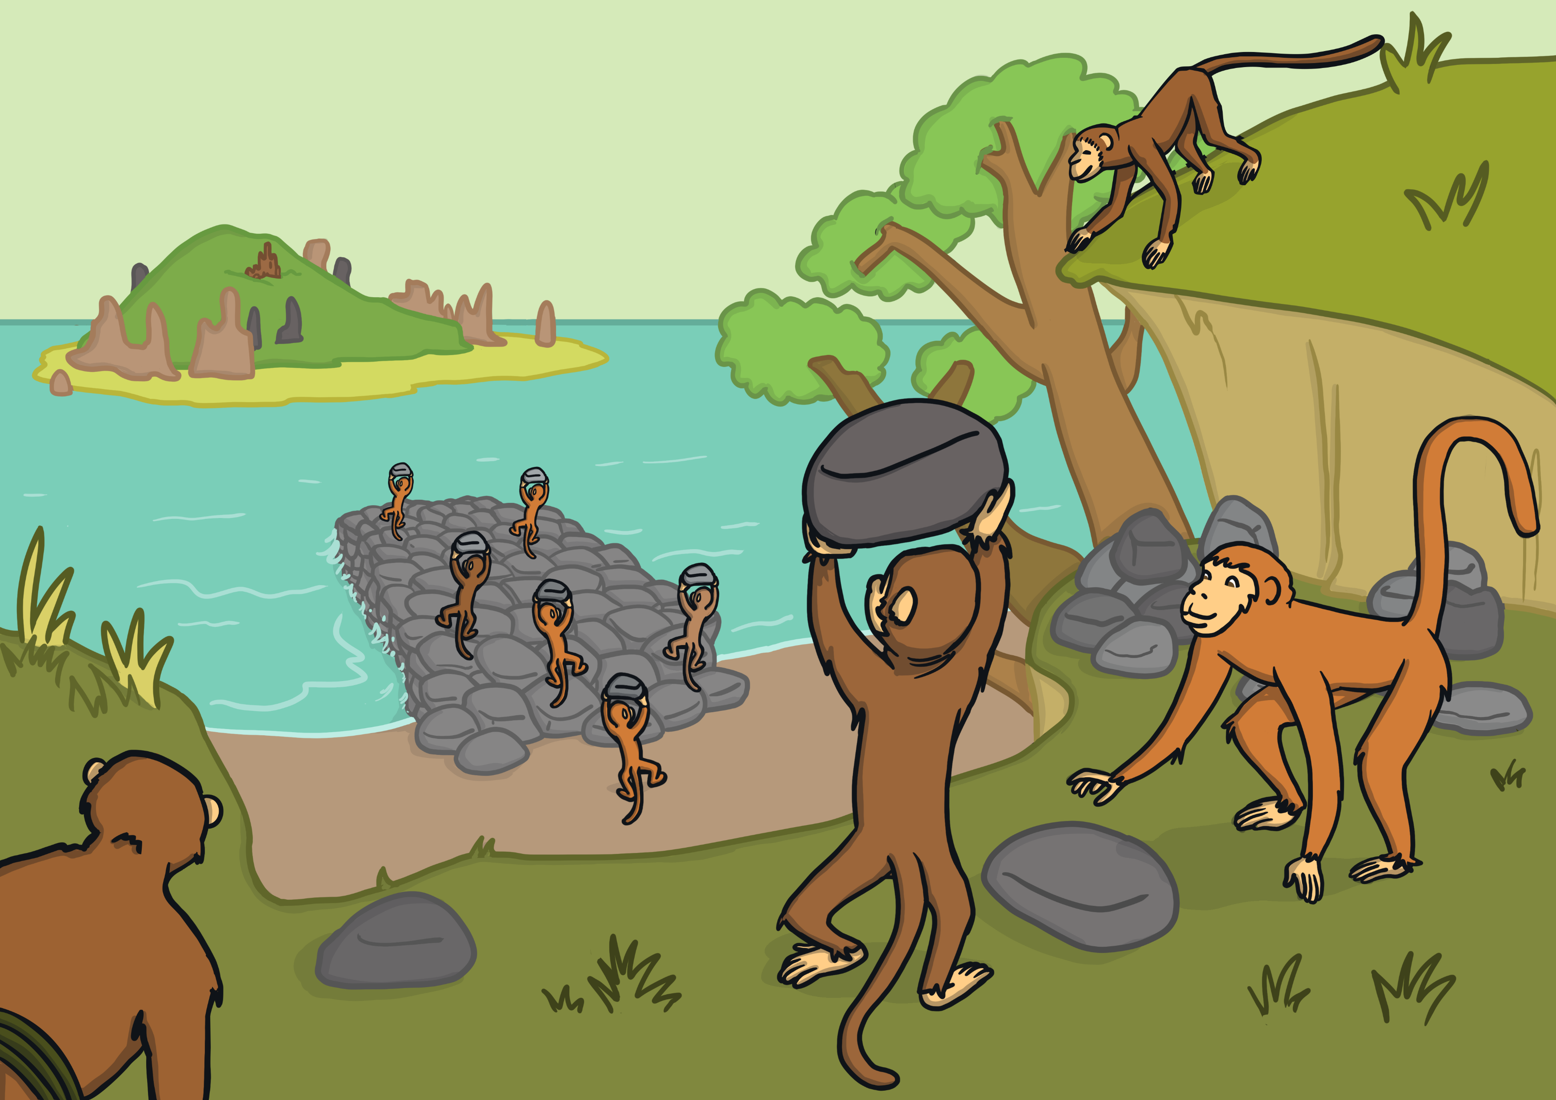
After a very long search, Hanuman found Sita imprisoned on an island. The army of monkeys couldn’t reach the island so they began to build a bridge. Soon, all the animals of the world, large and small, came to help.

Slide 8
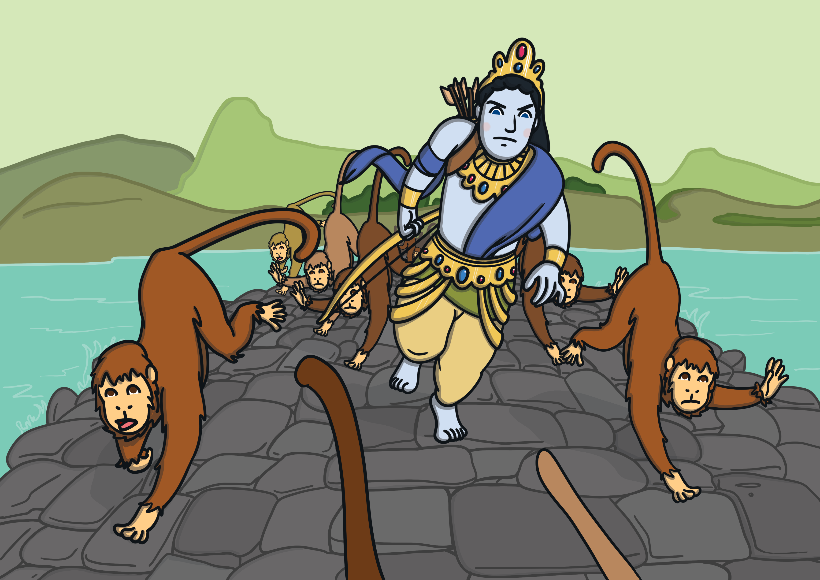
When the bridge was built, the monkeys and Rama rushed across it and
fought a mighty battle.

Slide 9
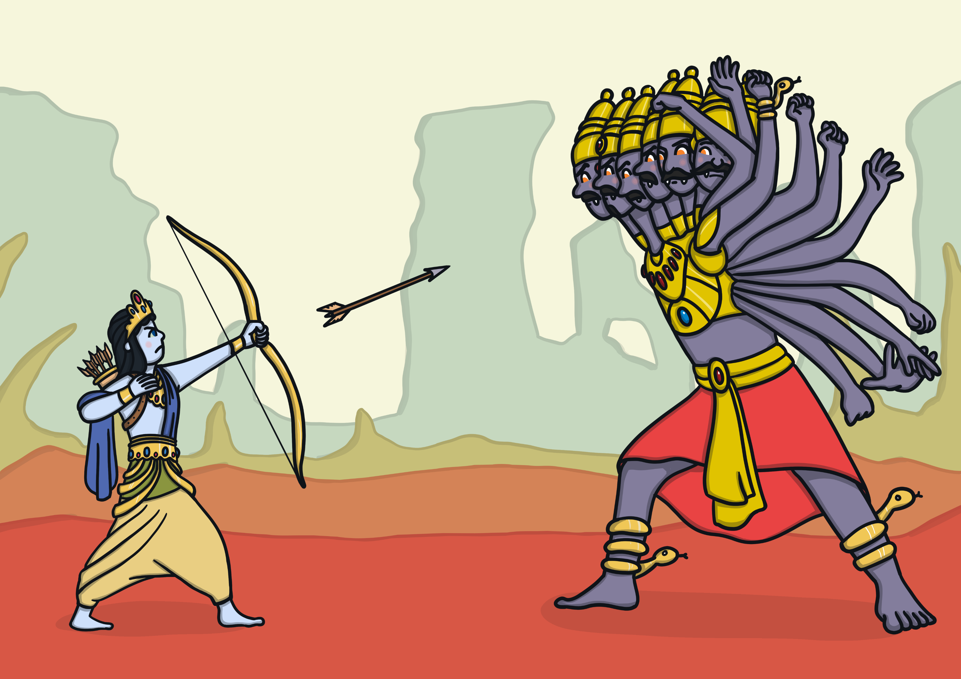
Rama killed the evil Ravana with a magic arrow and the whole
world rejoiced.

Slide 10
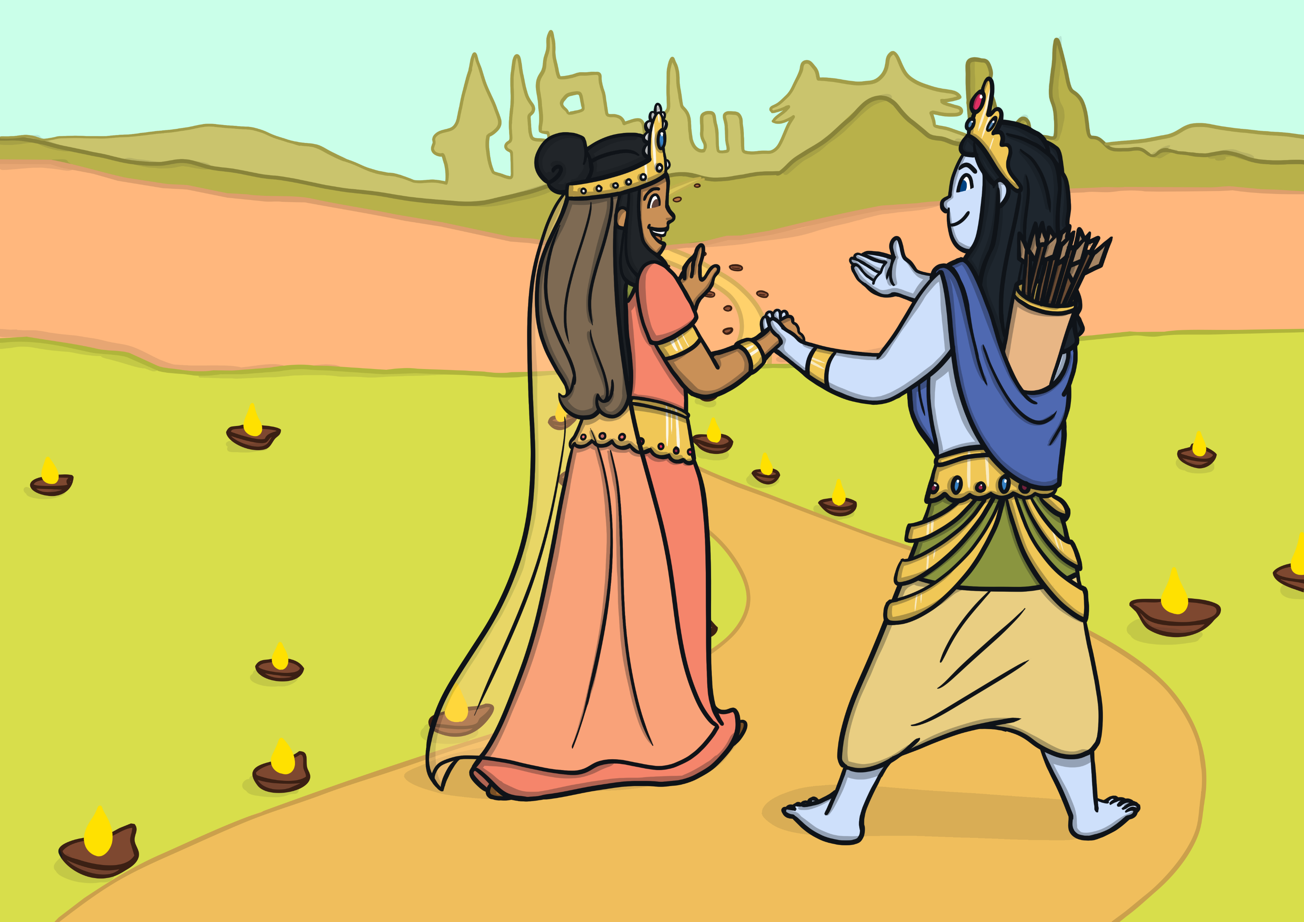
Rama and Sita were reunited and they began the long journey back to their land. Everybody lit lamps to guide them on the way and to welcome them back.

Slide 11
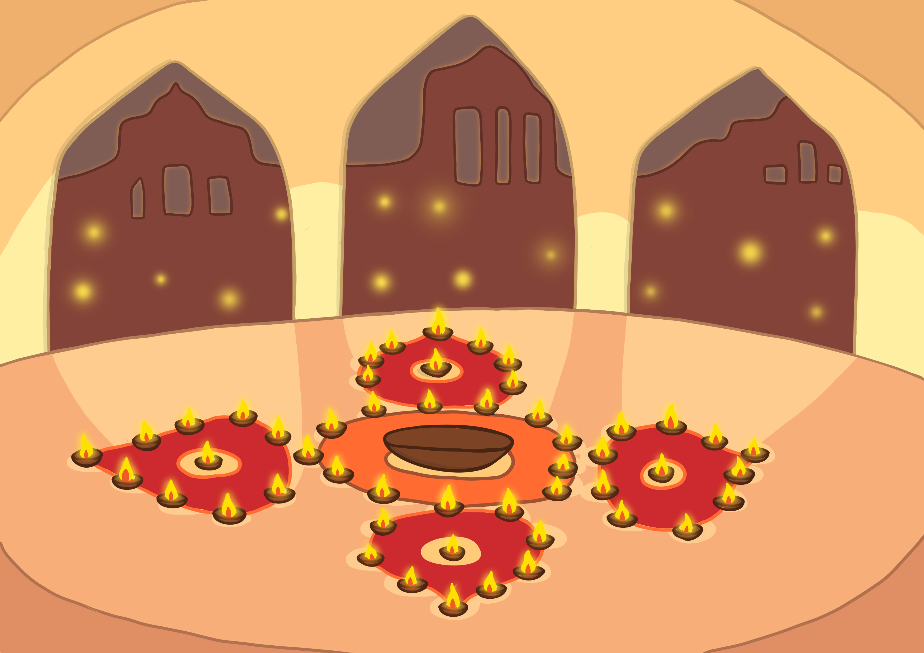
People light lamps at Diwali to remember that light triumphs over dark and good triumphs over evil.

