Slide 1
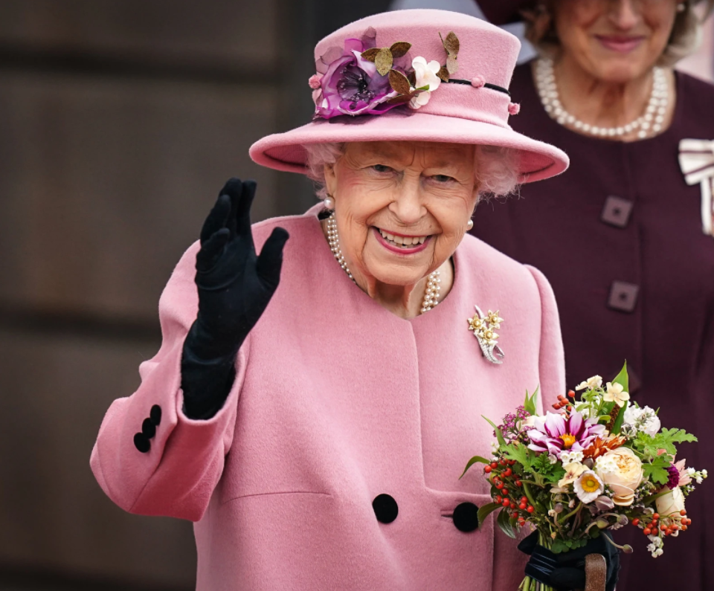
What toys did Queen Elizabeth II play with as a child?

Slide 2
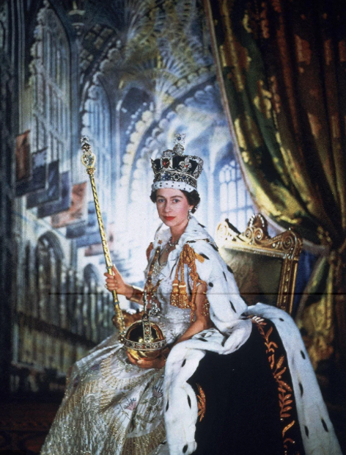
Our country has a monarchy.
A monarchy is a form of government that has a single person known as a monarch at its head. Monarchs use such titles as king, queen, emperor, or empress. This means that when the monarch dies, a son, daughter, or other relative becomes the next monarch.
Princess Elizabeth was born in 1926 and became our Queen in 1953 when she was 25 years old.

Slide 3
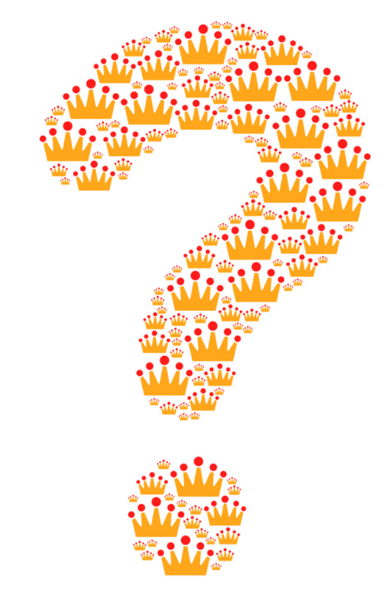
What toys do you think Queen Elizabeth played with when she was a little girl nearly 100 years ago?

Slide 4
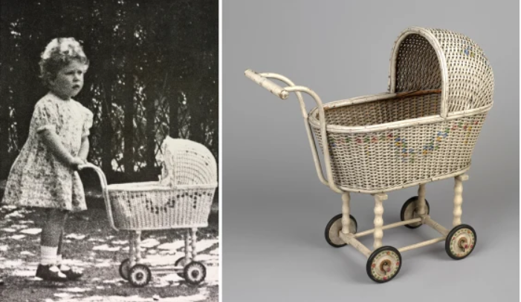
A two year old Princess Elizabeth with her pram in 1928.

Slide 5
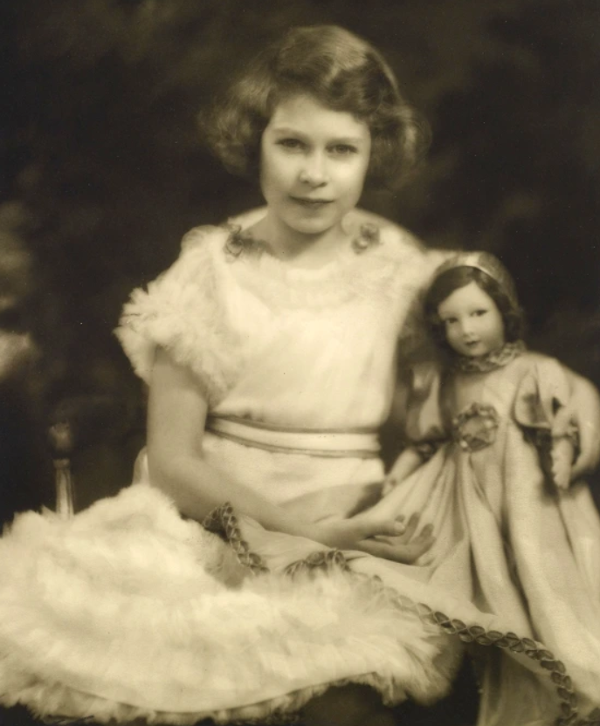
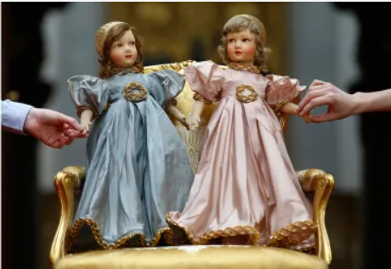
These china dolls belonged to Princess Elizabeth and Princess Margaret. Which one belonged to Princess Elizabeth?

Slide 6
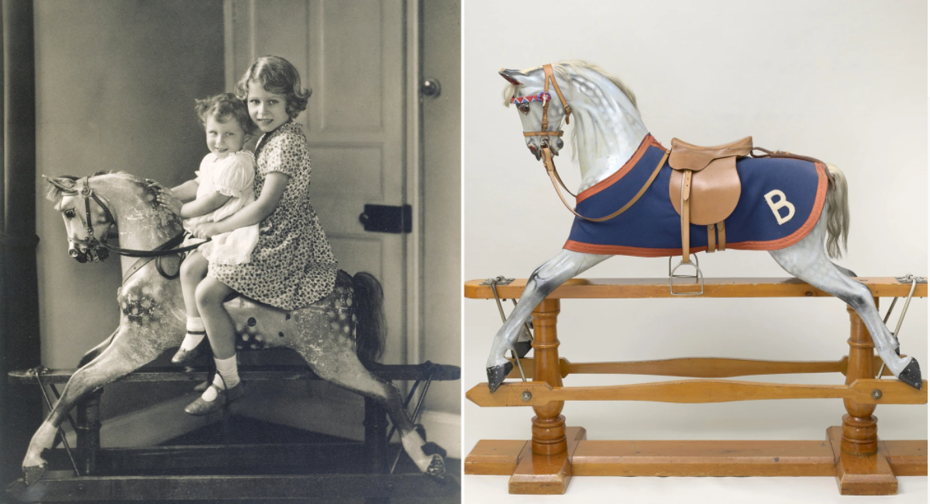
Princess Elizabeth and Princess Margaret on a rocking horse in 1932.

Slide 7
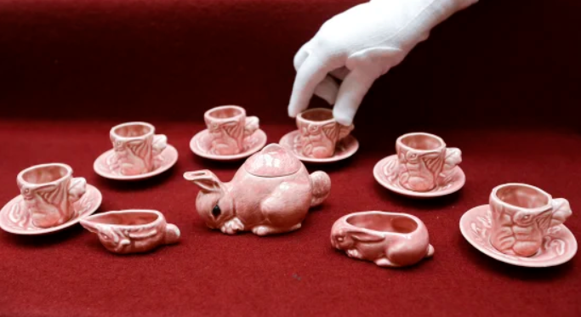
This pink tea set belonged to Queen Elizabeth.

